Slide 1
E-COMMERCE WEBSITE
Team-1
Mahesh Parikipandla
Pooja Kadam
Santhosh Kumar
Thanu Priya

Slide 2

CONTENTS
PROBLEM STATEMENT
SHORT DESCRIPTION
DESIGN
TECHNOLOGY USED
SCREEN SHOTS
CONCLUSION

Slide 3
PROBLEM STATEMENT
E-commerce provides an easy way to sell products to a large customer base. However, there is a lot of competition among multiple e-commerce sites. When users land on an e-commerce site, they expect to find what they are looking for quickly and easily. Also, users are not sure about the brands or the actual products they want to purchase. They have a very broad idea about what they want to buy. The purpose of any e-commerce website is to help customers narrow down their broad ideas and enable them to finalize the products.

Slide 4
SHORT DESCRIPTION
This project aims to develop an online shopping for customers with the goal so that it is very easy to shop things from a extensive number of online shopping site available on the web.
With the help of this you can carry out an online shopping from your home.
The perfect styles is designed for the users who wants to buy the products through these ecommerce website.
To get to this online shopping system all the customers will need to have a username and password to login proceed your shopping.
The login credentials for an online shopping strong and secure.

Slide 5
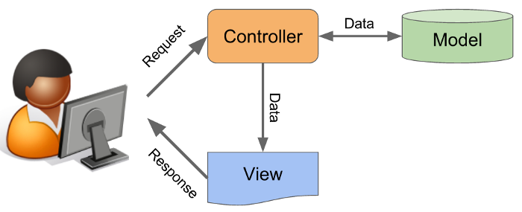
MVC ARCHITECTURE
MVC ( Model, View, Controller)

Slide 6
TECHNOLOGY USED
HTML
CSS
JAVA SCRIPT
JAVA
MY SQL
SPRING BOOT

Slide 7
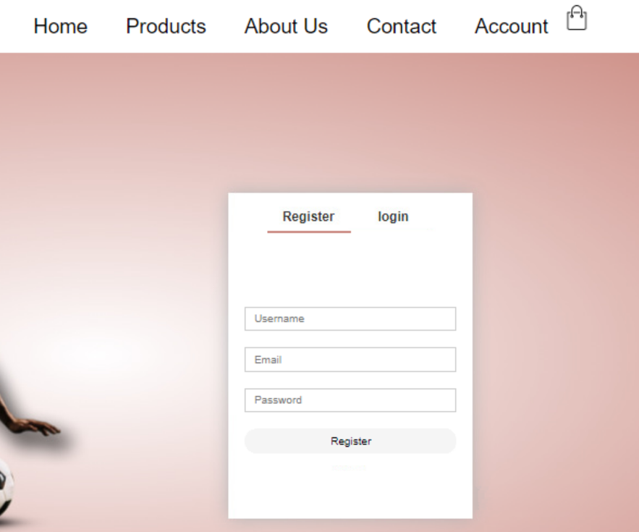
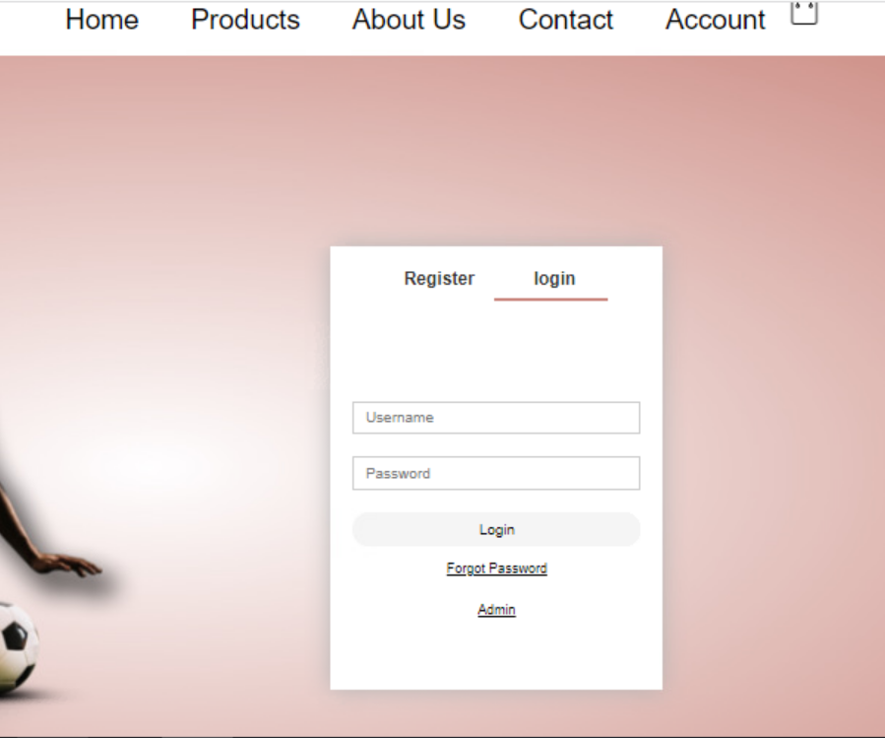
SNAP SHOTS

Slide 8
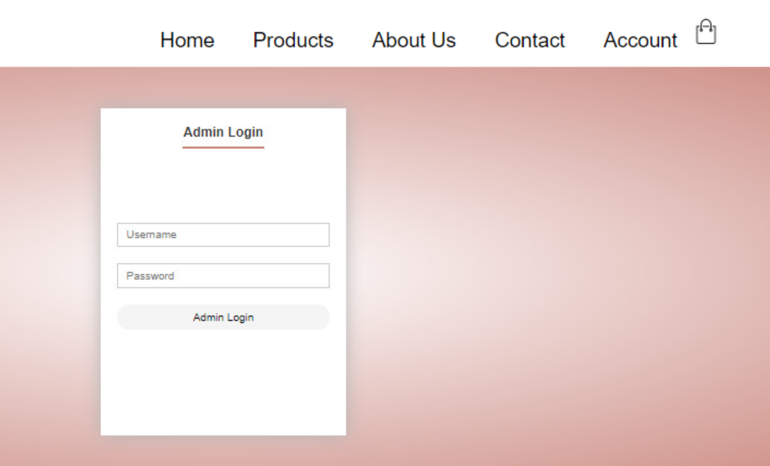
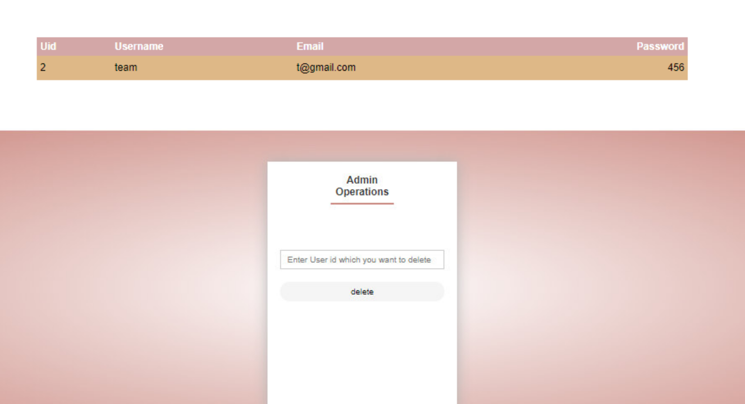
SNAP SHOTS

Slide 9
CONCLUSION AND FUTURE ENHANCEMENT
The online shopping portal gives user an experience to shop sitting at one place and exposure to the wide range of products at one website.
We have used Html, Css and Java Script to design frontend.
And also used Java, Spring Boot for the Backend.
Mysql for storing the data.
The future enhancement is to make the website more secure, interactive and dynamic.

Slide 10
THANK YOU

